Slide 1
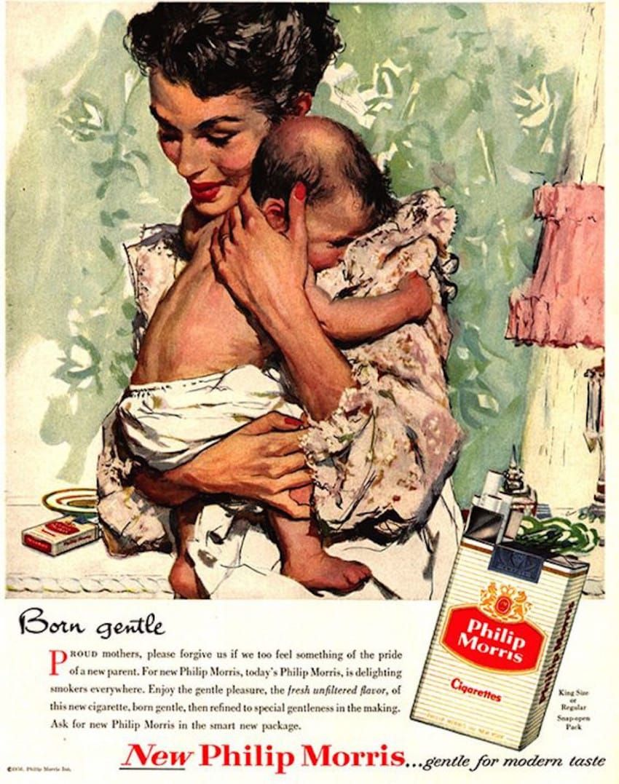
Selection Bias Video II
The Birthweight Paradox
Alan Fossa, MPH
Adapted from The Book of Why by Judea Pearl and Dana Mackenzie
Notes:
Hello everybody, in our last video we introduced the concept of selection bias in epidemiologic studies. Today we will see how our modern structural definition of selection bias helps us to resolve a historical paradox.

Slide 2
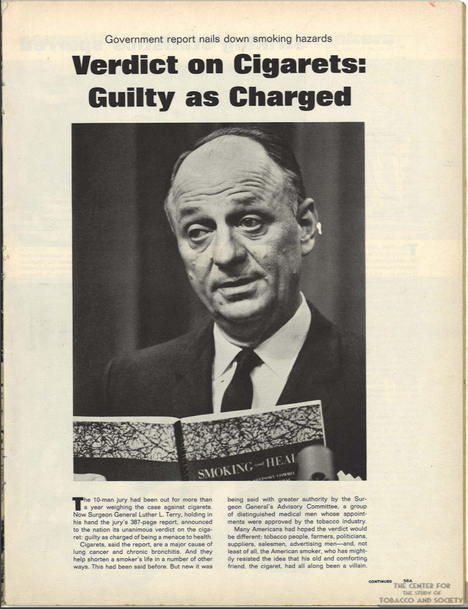
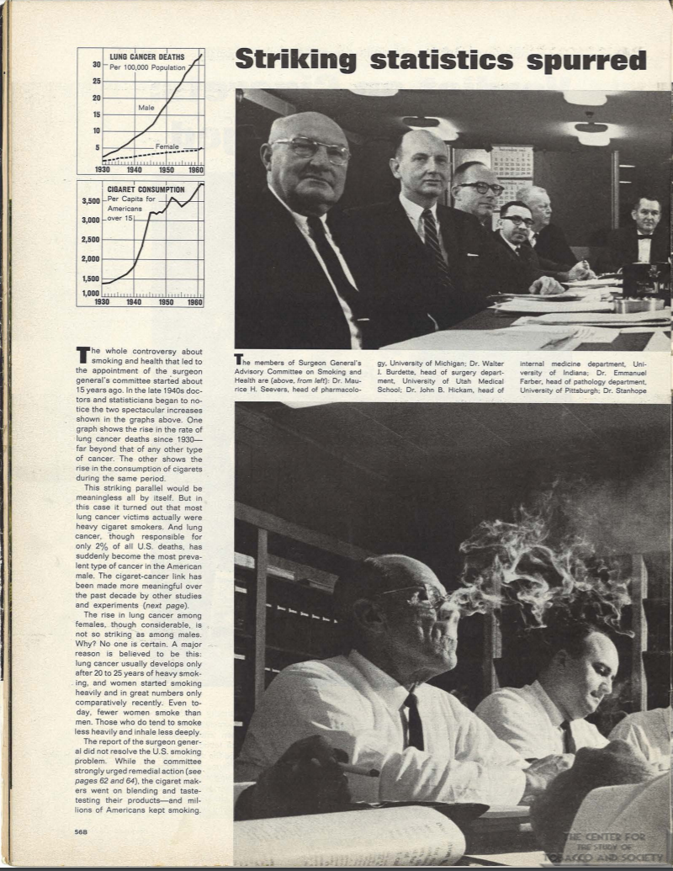
Source: Life Magazine via University of Alabama Center for Study of Tobacco and Society
Notes:
The consensus that smoking causes lung cancer is by far the most well-known example of drawing causal inference from observational data. The issue was hotly contested during the late 50’s and 60’s but following the surgeon general’s advisory commission report in 1963 and the recognition that smoking was a causative agent in lung cancer by the Royal College of Physicians the debate was mostly settled.

Slide 3
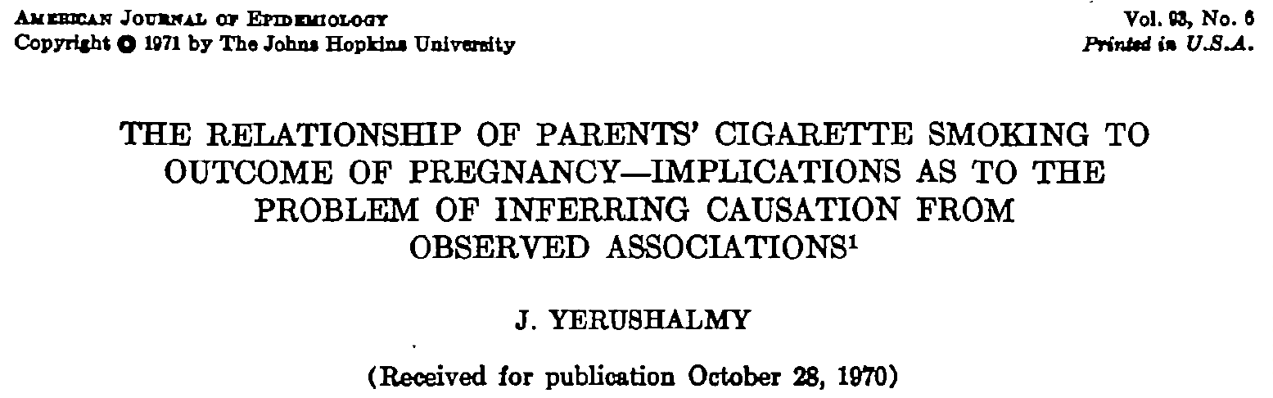
Notes:
One hold-out critic was a researcher named Jacob Yerushalmy. In 1971 Yerushalmy published a paper comparing the infant mortality rate of low-birthweight babies born to mothers who smoke and mothers who did not smoke during pregnancy. A number of studies up to that point had found that mothers who smoke during pregnancy are more likely to give birth to low birthweight babies.

Slide 4
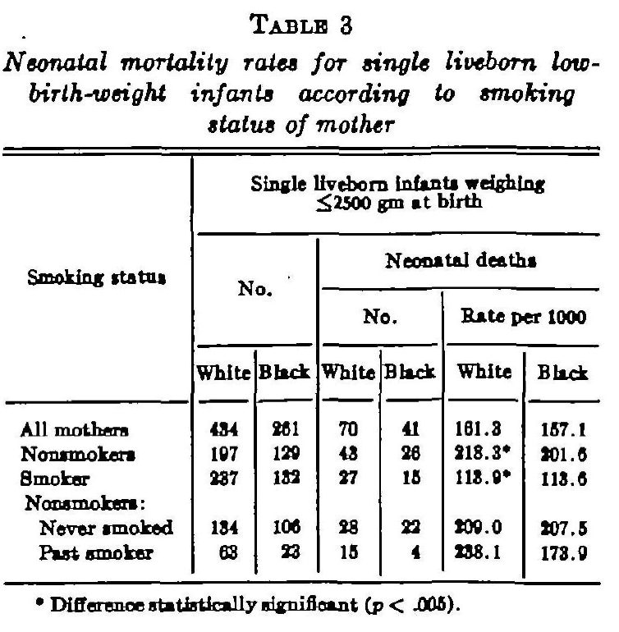
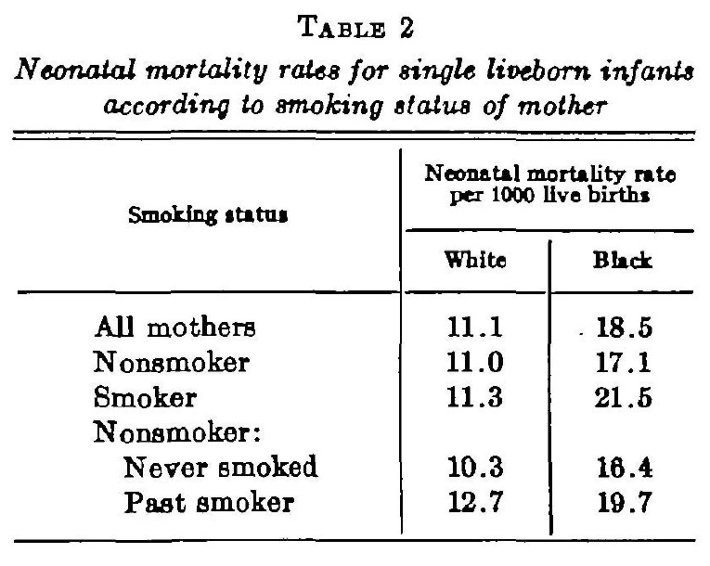
Notes:
However, the results Yerushalmy’s paper presented a paradox. He found that low birthweight babies born to mothers who smoked had lower infant mortality rates when compared to low birthweight babies born to mothers who did not smoke during pregnancy. How could this be? Does smoking during pregnancy protect more vulnerable infants from dying? It doesn’t make sense based on what we know about smoking, both back then and now. Yerushalmy presented his analysis as a cautionary tale when drawing causal inference from observational data. How can we reconcile these findings given our knowledge about bias in epidemiologic studies? Let’s start by drawing a DAG representing our study question.

Slide 5
Notes:
However, the results Yerushalmy’s paper presented a paradox. He found that low birthweight babies born to mothers who smoked had lower infant mortality rates when compared to low birthweight babies born to mothers who did not smoke during pregnancy. How could this be? Does smoking during pregnancy protect more vulnerable infants from dying? It doesn’t make sense based on what we know about smoking, both back then and now. Yerushalmy presented his analysis as a cautionary tale when drawing causal inference from observational data. How can we reconcile these findings given our knowledge about bias in epidemiologic studies? Let’s start by drawing a DAG representing our study question.

Slide 6
Mom smokes
during pregnancy

Slide 7
Mom smokes
during pregnancy
Infant mortality
Notes:
An important third variable to draw is low-birthweight.

Slide 8
Low birthweight
Mom smokes
during pregnancy
Infant mortality
Notes:
Recall that in DAGS when we condition on a variable we draw a box around that variable. Indeed in his analysis Yerushalmy conditioned on low-birthweight through restriction. So, let’s draw a box around low birthweight.

Slide 9
Low birthweight
Mom smokes
during pregnancy
Infant mortality

Slide 10
Low birthweight
Mom smokes
during pregnancy
Infant mortality
Notes:
We also know that smoking causes low birthweight. Let’s draw an arrow from smoking to low birthweight.

Slide 11
Low birthweight
Mom smokes
during pregnancy
?
Infant mortality
Notes:
Given our DAG one explanation of Abe’s results is that smoking has a protective effect on infant mortality. But based on our DAG why would conditioning on low birthweight make a difference? It doesn’t make sense both from a causal inference point of view and based on what we know about smoking. Let’s try something else.

Slide 12
Poor prenatal
nutrition
Low birthweight
Mom smokes
during pregnancy
Infant mortality
Notes:
We know that smoking is certainly not the only cause of low birthweight. Let’s consider poor pre-natal nutrition as a cause of low birthweight.

Slide 13
Poor prenatal
nutrition
Low birthweight
Mom smokes
during pregnancy
Infant mortality
Notes:
Let’s also consider it a cause of infant mortality.

Slide 14
Poor prenatal
nutrition
Low birthweight
Mom smokes
during pregnancy
Infant mortality
Notes:
Does this DAG shed light on the paradox presented in Yerushalmy’s paper? Let’s remember that when two variables share a common effect (a collider, in this case LBW) we open up a statistical association between these two variables if we condition on that collider. Restriction to LBW babies, as Abe did, effectively conditions on a collider between smoking and poor prenatal nutrition. This opens up a non-causal pathway between smoking and infant mortality but in the opposite direction as we would expect!
Let’s remember the structural definition of selection bias as bias due to conditioning on a collider. Logically if we know an infant is of low birthweight, and that infant’s mom did not smoke then something had to cause the low birth weight other than smoking. That infant is more likely to have poor prenatal nutrition and thus more likely to die in infancy thus inducing a negative association between smoking and LBW. Now we can never know that this is the true structure of the bias present in Abe’s study because there are many causes of LBW that we don’t have information on. However, this explanation makes sense given what we know about selection bias and it is a relatively straightforward historical example of the perils of selection bias and arbitrary restriction of subjects in a study.
If one wanted to study the effect of mothers smoking during pregnancy on infant mortality why would want to restrict our analysis to only LBW babies? Unfortunately, this type of arbitrary subgroup analysis is still common today and it is often a sign of investigators playing around with data until they find an interesting result. Given your new knowledge of selection bias you are better equipped to read studies with a critical eye. If you see inclusion or exclusion criteria listed in a study look for a specific reason it’s being done and what effect it may have on the results.

Slide 15
Poor prenatal
nutrition
Low birthweight
Mom smokes
during pregnancy
Infant mortality
Notes:
Does this DAG shed light on the paradox presented in Yerushalmy’s paper? Let’s remember that when two variables share a common effect (a collider, in this case LBW) we open up a statistical association between these two variables if we condition on that collider. Restriction to LBW babies, as Abe did, effectively conditions on a collider between smoking and poor prenatal nutrition. This opens up a non-causal pathway between smoking and infant mortality but in the opposite direction as we would expect!
Let’s remember the structural definition of selection bias as bias due to conditioning on a collider. Logically if we know an infant is of low birthweight, and that infant’s mom did not smoke then something had to cause the low birth weight other than smoking. That infant is more likely to have poor prenatal nutrition and thus more likely to die in infancy thus inducing a negative association between smoking and LBW. Now we can never know that this is the true structure of the bias present in Abe’s study because there are many causes of LBW that we don’t have information on. However, this explanation makes sense given what we know about selection bias and it is a relatively straightforward historical example of the perils of selection bias and arbitrary restriction of subjects in a study.
If one wanted to study the effect of mothers smoking during pregnancy on infant mortality why would want to restrict our analysis to only LBW babies? Unfortunately, this type of arbitrary subgroup analysis is still common today and it is often a sign of investigators playing around with data until they find an interesting result. Given your new knowledge of selection bias you are better equipped to read studies with a critical eye. If you see inclusion or exclusion criteria listed in a study look for a specific reason it’s being done and what effect it may have on the results.

Slide 16
Evaluating selection bias
Do the authors impose any inclusion or exclusion criteria to their study population? Is there substantial loss to follow-up in the study?
Do they give a good reason why? Did they do anything to account for this?
What effect could this have on the results of the study based on what you know about selection bias?
Draw a DAG

Slide 17
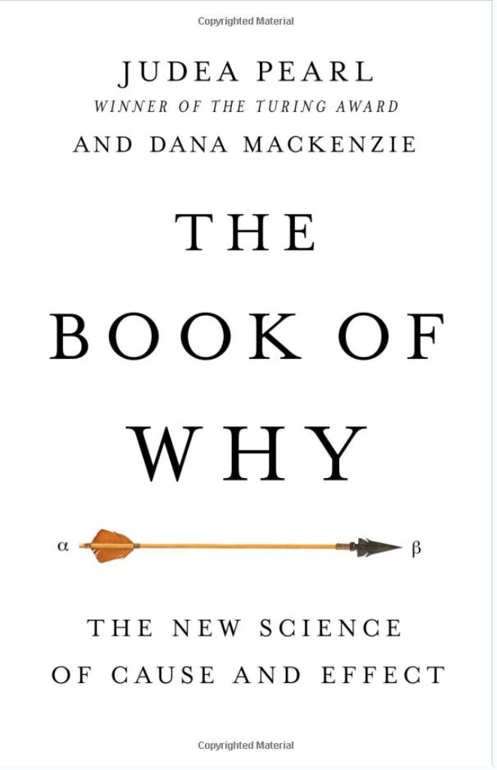
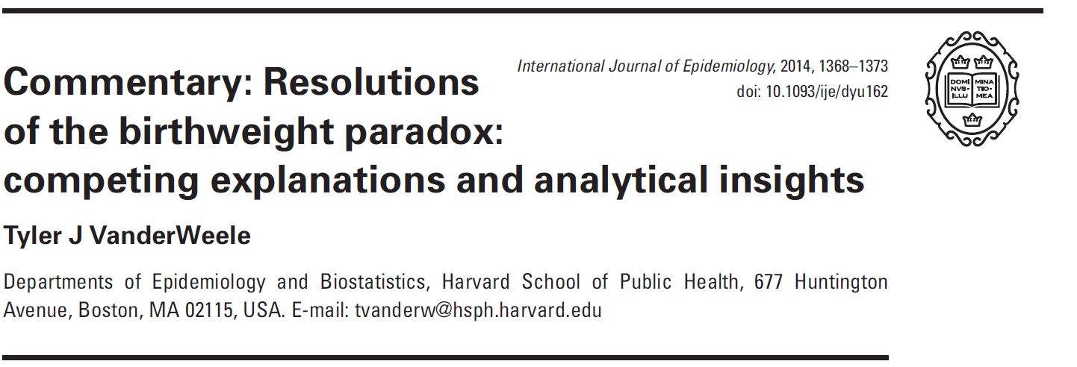
Notes:
If you want to know more about this example I encourage you to read two papers on this topic posted on canvas. One is the original study in question and the other is a causal explanation for the results by Tyler Vanderweele who is a prominent epidemiologist in the field of causal inference. This example was highly adapted from The Book of Why by Judea Pearl. I highly recommend this book for anybody taking this course. It is very readable and provides many interesting examples and explanations of modern day causal inference. Looking forward to discussing this issue more with you in lecture.

Slide 18
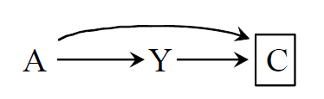
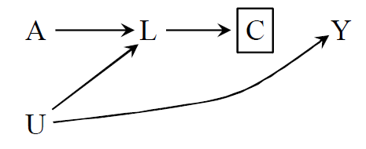
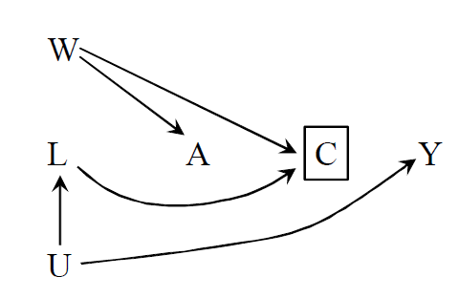
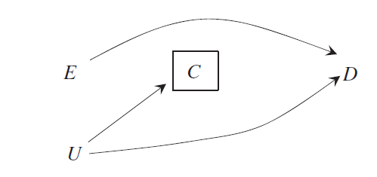

Examples
Selection Bias Cheat Sheet
Structural definition: Bias resulting from conditioning on a common effect (a collider) of two variables, one of which is the exposure or associated with the exposure and the other is either the outcome or associated with the outcome.* (Adapted from Hernán, Hernández-Díaz, and Robins 2004).
Structure | Study
Epidemiologist rely on data to make causal inferences about the way the world works. Considering the structure of the process which generates the data strengthens our ability to use data for this purpose. There are three ways in which two variables may be associated in a dataset.
A → Y :This is a true causal association between A and Y. That is, the probability of Y sensitive to A.
A←C→Y : There is a common cause of both A and Y. C is commonly referred to as a confounder or “the lurking third variable”.
A→S←Y: S is a collider or a common outcome of both A and Y. In a population A and Y are statistically independent. However, within levels of S (conditioning on S) there is a statistical association between A and Y. S is referred to as a collider.
A study of the effect of folic acid (A)
at conception on the prevalence of
birth defects (Y). Only those babies
Born were included in the study (C).
General definition: Bias that arises when the parameter of interest in a population differs from the parameter in the subset of individuals from the population that is available for analysis. (Hernán, 2017)
A study of the effect of AZT (A) on development of AIDS (Y). Treatment A and illness severity (U) both cause side effects (L) which leads to dropout (C). See 2x2 example for another prospective.
*There are some examples of selection bias that do not meet this definition. This type of selection bias arises only under the non-null situation and requires interaction between E and U to cause D. This type of “off the null” selection bias relates more to generalizability. (Hernán, 2017)
What can be done about selection bias?
Better study design.
Inverse probability weighting of selection. (See back of this sheet)
A study of occupational exposure (A) on risk of stroke (Y). The terrible work conditions of the job (W) is a common cause of exposure (A) and likelihood that a person will quit (C). Underlying health status (U) is a cause of stroke (Y) and causes a person to quit (C) through deteriorating physical health (L). This is also called the “healthy worker effect”.
How does selection bias differ from confounding?
1. Structurally, selection bias differs from confounding
in that selection bias arises from collider stratification
rather than failing to condition on a common cause of
the exposure and outcome.
2. While randomized experiments are not vulnerable
to confounding they are vulnerable to selection bias
because of differential loss to follow-up. In fact, while
case-control studies are thought to be most vulnerable to
selection bias, measures of association in any type of study
can be biased due to collider stratification.
A hospital-based case control study of the malnutrition (A) on depression (Y). Because of the study design those with depression (Y) are more likely to be included in the study (C). Malnutrition by itself is likely to cause somebody to be admitted to the hospital (C). This is also called “Berkson’s bias”
Y₁
Y₀
The AZT study examples viewed from
the prospective of a 2x2 table. Since A
U both cause participants to drop out,
we under sample those who are exposed
who are likely to develop the outcome. This
leads to an inverse association between A
and Y under the null.
A₁
A₀
Examples adapted from: Hernán MA, Robins JM (2020).
Causal Inference: What If. Boca Raton: Chapman & Hall/CRC.

Slide 19
Inverse Probability Weighting for Selection Bias
A(PFAS Exposure) | M(Birth defect) | C(Prenatal mortality) | W^{c} (Inverse probability weights)
0 | 1 | 0
0 | 1 | 1
0 | 0 | 0
0 | 0 | 0
1 | 1 | 1
1 | 1 | 1
1 | 1 | 0
1 | 0 | 1
1 | 0 | 1
1 | 0 | 0
Consider a study of the effect of PFAS exposure (A) on birth defects (M).
You enroll pregnant women, half of whom are exposed to PFAS
at conception . Exposed or not, half of fetuses develop malformations (A has
no causal effect on M). Both PFAS exposure and birth defects independently increase the likelihood that the fetus will die before being born (C). Your study is limited to only babies that survived until birth.
RR in the population: Pr[M=1|A=1]/Pr[M=1|A=0]:
RR in your study: : Pr[M=1|A=1,C=0]/Pr[M=1|A=0,C=0]:
Inverse probability weights:
For exposed with defects: 1/(Pr[C=0|A=1,M=1]:
For exposed without defects: 1/ Pr[C=0|A=1,M=0]:
For unexposed with defects: 1/(Pr[C=0|A=0,M=1]:
For unexposed without defects: 1/Pr[C=0|A=0,M=0]:
RR in your study using inverse probability weights:

